Slide 1

Course code : CSE3009 Course title : No SQL Data Bases Module : 2 Topic : 5
Bigdata distribution models and Map Reduce

Slide 2
Objectives
This session will give the knowledge about
Using NoSQL to manage big data
What is a big data NoSQL solution?
Bigdata distribution models and Map Reduce
Classifying big data problems
The challenges of distributed computing for big data

Slide 3
Using NoSQL to manage big data
Twenty years ago, companies managed datasets that contained approximately a million internal sales transactions, stored on a single processor in a relational database.
As organizations generated more data from internal and external sources, datasets expanded to billions and trillions of items.
The amount of data made it difficult for organizations to continue to use a single system to process this data. They had to learn how to distribute the tasks among many processors. This is what is known as a big data problem.

Slide 4
What is a big data NoSQL solution?
A big data problem is any business problem that’s so large that it can’t be easily managed using a single processor.
Big data problems force you to move away from a single-processor environment toward the more complex world of distributed computing.
Here are some of the challenges you face when you move from a single processor to a distributed computing system.

Slide 5
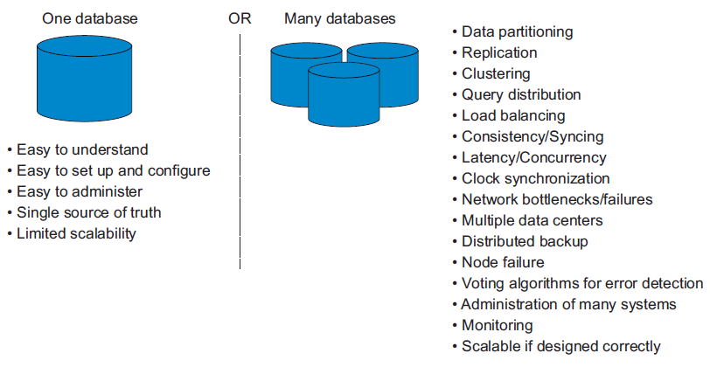
What is a big data NoSQL solution?

Slide 6
Big data use cases
Here are some typical big data use cases:
Bulk image processing
Public web page data
Remote sensor data
Event log data
Mobile phone data
Social media data
Game data
Open linked data

Slide 7
Big data use cases
Among these use cases, some problems can be described as independent parallel transforms since the output from one transform isn’t used as an input to another.
Read and write to key-value stores or distributed file systems like Amazon’s Simple Storage Service (S3) or Hadoop Distributed File System (HDFS) and may not need the advanced features of a document store or an RDBMS.
Big data problems like event log data and game data do need to store their data directly into structures that can be queried and analyzed, so they will need different NoSQL solutions

Slide 8
Good NoSQL Solutions to Big data problems
To be a good candidate for a general class of big data problems, NoSQL solutions should
Be efficient with input and output and scale linearly with growing data size.
Be operationally efficient. Organizations can’t afford to hire many people to run the servers.
Require that reports and analyses be performed by nonprogrammers using simple tools.
Meet the challenges of distributed computing, including consideration of latency between systems and eventual node failures.

Slide 9
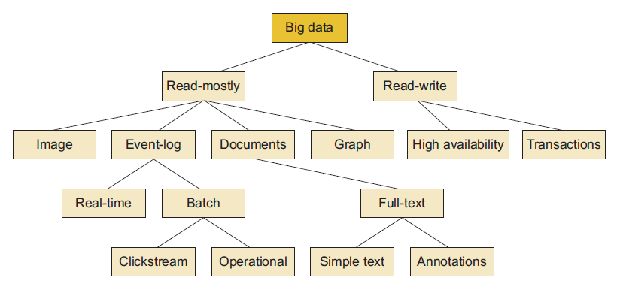
Understanding the types of big data problems
There are many types of big data problems, each requiring a different combination of NoSQL systems.
A Good example of a high-level big data classification system is

Slide 10
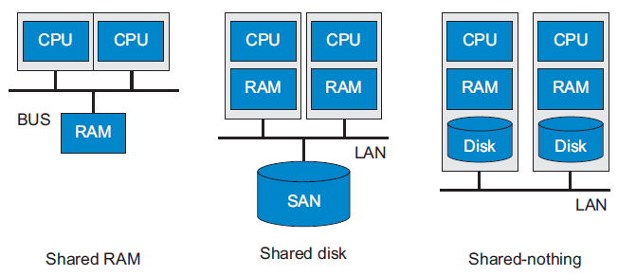
Analyzing big data with a shared-nothing architecture
There are three ways that resources can be shared between computer systems: shared RAM, shared disk, and shared-nothing.

Slide 11
Shared-nothing architecture
The left panel shows a shared RAM architecture, where many CPUs access a single shared RAM over a high-speed bus. This system is ideal for large graph traversal.
The middle panel shows a shared disk system, where processors have independent RAM but share disk using a storage area network (SAN).
The right panel shows an architecture used in big data solutions: cache-friendly, using low-cost commodity hardware, and a shared-nothing architecture.

Slide 12
Choosing distribution models: Master-Slave VS Peer-to-Peer
From a distribution perspective, there are two main models: master-slave and peer-to peer.
Distribution models determine the responsibility for processing data when a request is made.
Understanding the pros and cons of each distribution model is important when you’re looking at a potential big data solution.
Peer-to-peer models may be more resilient to failure than master-slave models. Some master-slave distribution models have single points of failure that might impact your system availability.

Slide 13
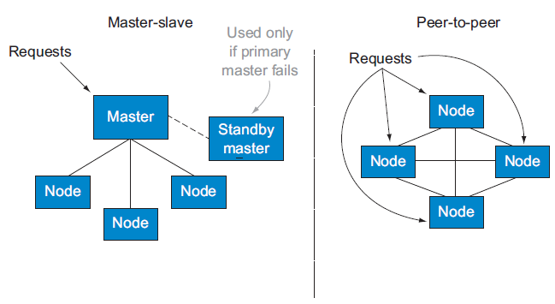
Master-Slave VS Peer-to-Peer

Slide 14
Master-Slave VS Peer-to-Peer
The panel on the left illustrates a master-slave configuration where all incoming database requests (reads or writes) are sent to a single master node and redistributed from there.
The master node is called the Name Node in Hadoop. This node keeps a database of all the other nodes in the cluster and the rules for distributing requests to each node.
The panel on the right shows how the peer-to-peer model stores all the information about the cluster on each node in the cluster.
If any node crashes, the other nodes can take over and processing can continue.

Slide 15
MapReduce to transform data over distributed systems
MapReduce systems can be used to process large datasets on multiple processors.
If you’ve been moving data between SQL systems, you’re familiar with the extract, load, and transform (ETL) process.
SQL-based ETL systems usually don’t have the inherent ability to use a large number of processors to do their work.
This single-processor bottleneck is common in data warehouse systems as well as areas of big data.

Slide 16
MapReduce
To solve this type of problem, organizations have moved to a distributed transformation model built around the map and reduce functions.
To effectively distribute work evenly over a cluster of processors, the output of a map phase must be a set of key-value pairs where part of the key structure is used to correlate results into the reduce phase.
These functions are designed to be inherently linearly scalable using a large number of shared-nothing processors.

Slide 17
MapReduce
Traditional file systems store data in a single location; if a drive fails, data is restored from a backup drive.
By default, files in HDFS are stored in three locations; if a drive fails, the data is automatically replicated to another drive. It’s possible to get the same functionality using a fault-tolerant system like RAID drives.
HDFSs are different: they use a large (64 megabytes by default) block size to handle data. Figure shows how large HDFS blocks are compared to a typical operating system.

Slide 18
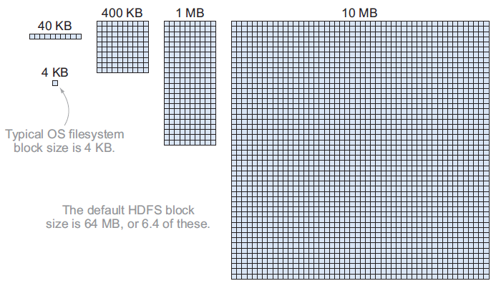
MapReduce

Slide 19
MapReduce
MapReduce is a programming framework that allows us to perform distributed and parallel processing on large data sets in a distributed environment.
MapReduce consists of two distinct tasks — Map and Reduce.
As the name MapReduce suggests, reducer phase takes place after the mapper phase has been completed. So, the first is the map job, where a block of data is read and processed to produce key-value pairs as intermediate outputs.

Slide 20
MapReduce
The output of a Mapper or map job (key-value pairs) is input to the Reducer.
The reducer receives the key-value pair from multiple map jobs.
Then, the reducer aggregates those intermediate data tuples (intermediate key-value pair) into a smaller set of tuples or key-value pairs which is the final output.

Slide 21
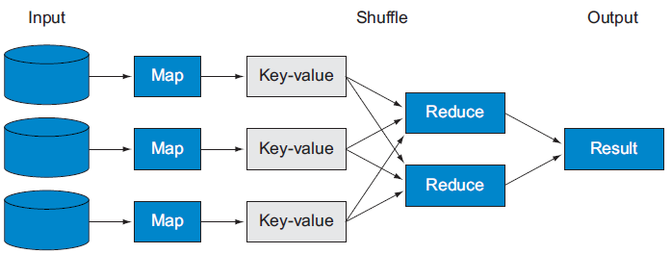
MapReduce
This figure explain how MapReduce transfers the data over distributed system.

Slide 22
MapReduce
The basics of how the map and reduce functions work together to gain linear scalability over big data transforms.
The map operation takes input data and creates a uniform set of key-value pairs.
In the shuffle phase, which is done automatically by the MapReduce framework, key-value pairs are automatically distributed to the correct reduce node based on the value of the key.
The reduce operation takes the key-value pairs and returns consolidated values for each key. It's the job of the MapReduce framework to get the right keys to the right reduce nodes.

Slide 23
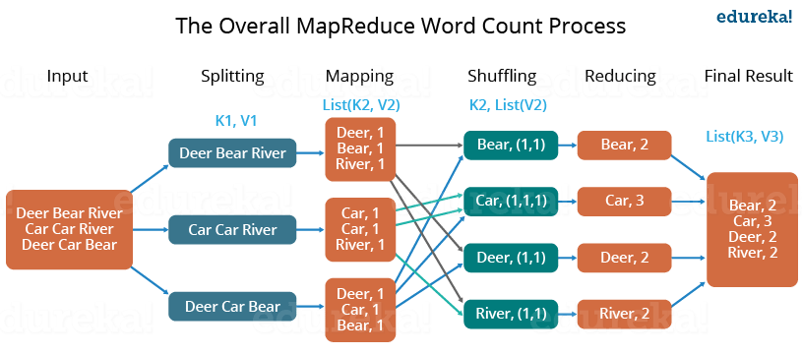
Word Count Example of MapReduce
example.txt: Dear, Bear, River, Car, Car, River, Deer, Car and Bear

Slide 24
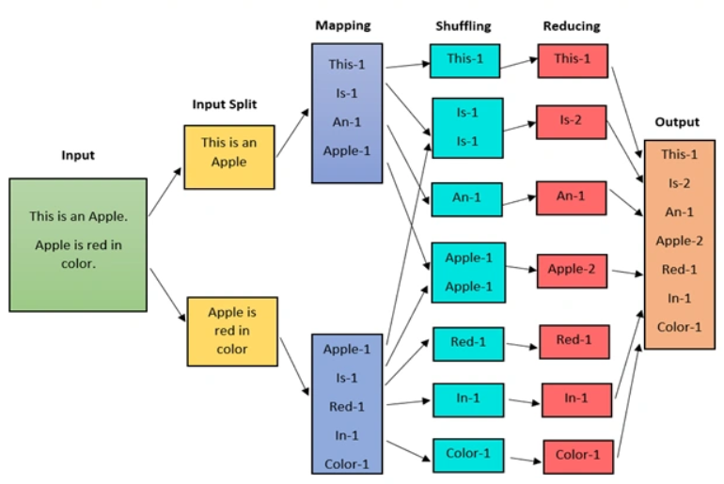
Word Count Example of MapReduce

Slide 25
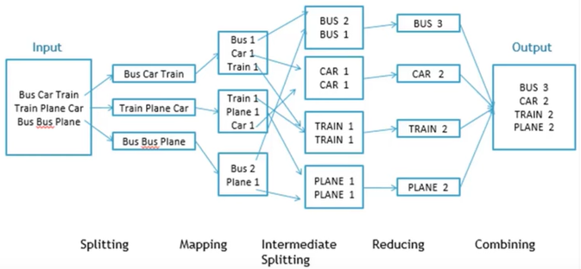
Word Count Example of MapReduce

Slide 26
MapReduce with MongoDB
The basics of how the map and reduce functions work together to gain linear scalability over big data transforms.
The map operation takes input data and creates a uniform set of key-value pairs.
In the shuffle phase, which is done automatically by the MapReduce framework, key-value pairs are automatically distributed to the correct reduce node based on the value of the key.
The reduce operation takes the key-value pairs and returns consolidated values for each key. It's the job of the MapReduce framework to get the right keys to the right reduce nodes.

Slide 27
Summary
This session will give the knowledge about
Using NoSQL to manage big data
What is a big data NoSQL solution?
Bigdata distribution models and Map Reduce
Classifying big data problems
The challenges of distributed computing for big data

